Slide 1


A Presentation on
Manoeuvring of Micro Robots using External Magnetic Fields
MN 206: Dissertation Project
Project Guides:
Prof. G K Ananthasuresh, Assoc.Prof. Kaushik Chatterjee,
By-
Sameer Suhas Pujari Sr. No: 18768
S. Surya Teja Sr. No: 18188

Slide 2





Agenda of Presentation:
Introduction
System Design
Experimental Verification
Control Strategy
Future Work
What are Micro robots?
Magnetic Control of micro-bots
Application
Motivation

Slide 3




1. Introduction – What are Micro Robots?
Robotics
Involves the manipulation of physical objects by sensing their environment, does computation and uses an energy source for its actuation.
Micro-size Robotics:
Micro-size robotics is the field of robotics where the design and fabrication of robotic agents are in the range of micrometres.
The robots are capable of handling the manipulation of micrometre size components.
Issues with traditional manipulation at the micro-scale:
Scaling of physical effects is non-intuitive at the micro-scale.
e.g., Adhesive Forces, Frictional forces become more prominent than the Inertial and Buoyancy forces.
Requirement of external supply and actuation of robots.
Energy supply and control of robots are possible only through external systems, because of constraints in space, design, and manufacturability of the system at the micro-scale.
References:
Chowdhury S, Jing W, Cappelleri DJ (2015) Controlling multiple microrobots: recent progress and future challenges. Journal of Micro-Bio Robotics, pp 1–11
https://www.wevolver.com/article/tiny.vibrationpowered.robots.are.the.size.of.the.worlds.smallest.ant
23-06-2022
3

Slide 4

System Design Methodology/ Approach :
Mechanisms to actuate the Microrobots
Optical
Electrostatic
Magnetic
Reason for using magnetic actuation
A magnetic manipulation system can wirelessly transfer actuation power to microrobots that have minimal space for onboard energy
This technique doesn’t affect properties of sample solution such as pH value, ion concentration and temperature.
It’s ease of operation, low cost and simple design makes it a favorable option
23-06-2022
References: Ahmed Munaz, Md. J.A. Shiddiky and Nam-Trung-Nyugen (2018) Recent advances and current challenges in magnetophoresis based micro magnetofluidics

Slide 5

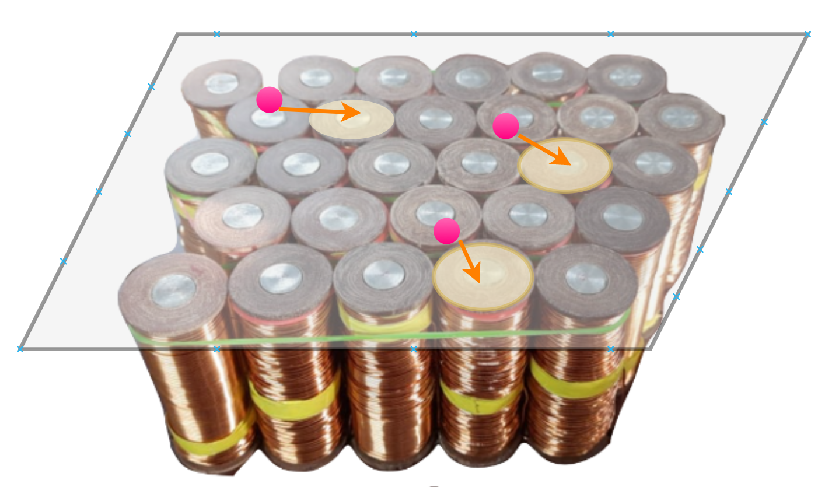
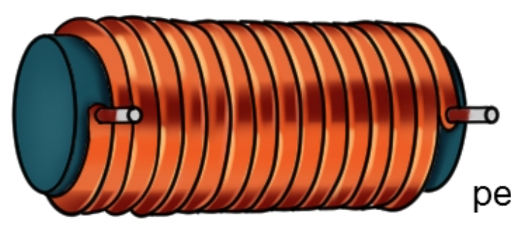
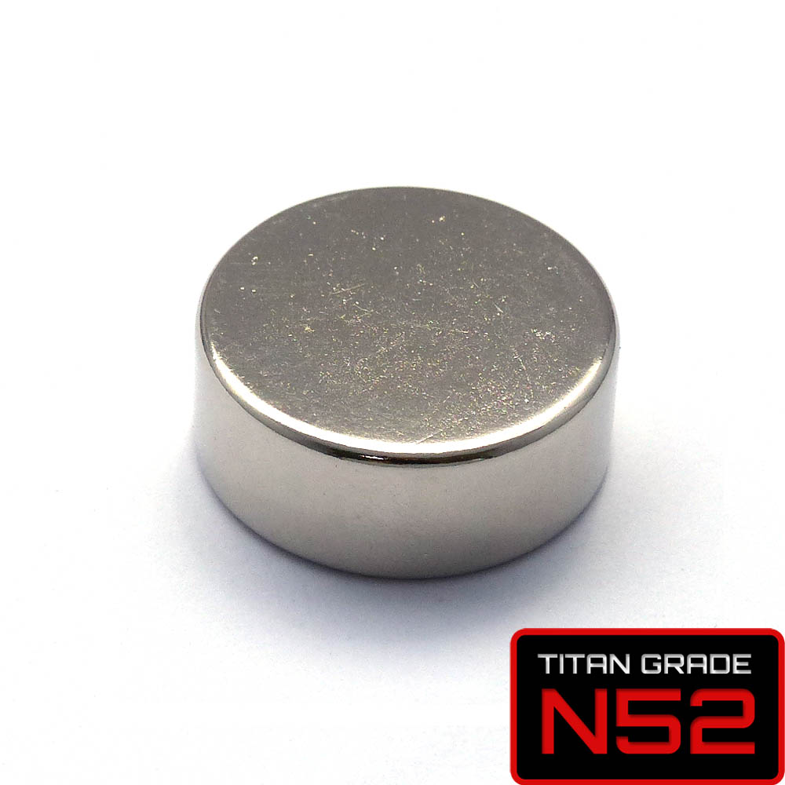
Types of Magnetic Field Generation System:
Coil
Micro-Bot
Micro-Bot
Coil
Fig1. Global Field System
Fig2. Local Field System
Field changes throughout the workspace
Needs very powerful magnetic systems for large workspaces
Every magnetic bot in the workspace is affected by the same coils
Independent control of multiple magnetic bots is very difficult
Workspace is limited.
3D manipulation is possible
Every coil effects only a small space in the workspace
Needs many relatively smaller electromagnets
Every magnetic bot in the workspace is affected by different coils
Independent control of multiple magnetic bots is possible
Workspace can be easily extended.
Restricted to 2D manipulation
References: Modelling and validation of magnetic field and force

Slide 6



Applications:
In Manufacturing:
Assembling and Dissembling of Micro-sized components
Non Magnetic Parts Re-orientation
In Medicine:
Human body Exploration
Operations where micro movements are required
Attaching cells to form a Colony
Targeted Drug Delivery
Tactile Feedback Glove in Teleoperation
Video Reference 1: Octomag system from ETH Zurich at MSR Lab showing an untethered magnetic robot puncturing of a blood vessel of eye.
Video 2: Assembling components using Magnetic Manipulation
Credits: Talha Faiz
Global Control
Localized Control

Slide 7




Motivation:
Magnetic actuation is helpful in operating an enclosed system at micro scale.
The setup can operate on micro scale systems, to perform micro manipulation tasks
Hence, the objective is to build a 2D platform(PCB) having a grid of coils on which a micro robot is placed, and it is actuated by the external magnetic fields.

Slide 8


Agenda of Presentation:
Introduction
System Design
Experimental Verification
Control Strategy
Future Work
Details of the bot
Designing PCB
Losses in the Coil

Slide 9
System Design:
a. Details of the Micro Robot:
Material of the Micro Robot:
The micro robot is controlled using an external magnetic field. Hence the robot can either be a
Permanent Magnet (or)
Ferro Magnet
Shapes and sizes of the Micro Robot:
Micro robots can be available in different basic geometries such as a cube, sphere and a cylinder
We have chosen a cylindrical micro robot because
These can be easily manoeuvred and controlled on a 2D platform.
The Magnetization of cylindrical micro robot is high along the axis of cylinder.
These are readily available in different dimensions in the market
References: Local Magnetic Field Design and Characterization for Independent Closed-Loop Control of Multiple Mobile Microrobots

Slide 10
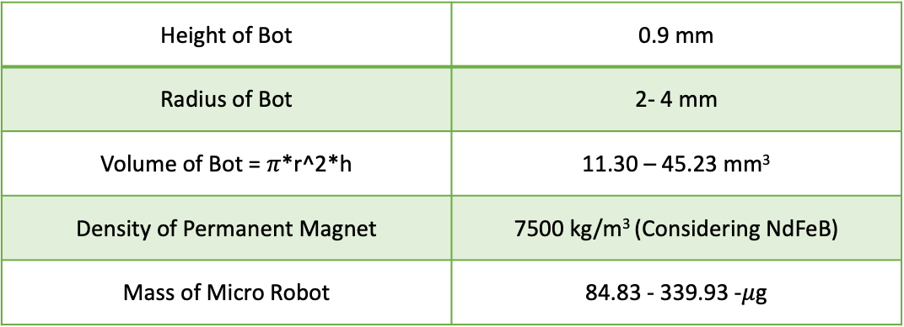
System Design:
a. Details of the Micro Robot:
The dimensions of the Micro Robot are as follows:
Height of Bot | 0.9 mm
Radius of Bot | 2- 4 mm
Volume of Bot = $π$*r^2*h | 11.30 – 45.23 mm³
Density of Permanent Magnet | 7500 kg/m³ (Considering NdFeB)
Mass of Micro Robot | 84.83 - 339.93 -$μ$g
4-8 mm
0.9mm
Fig 3. Micro Robot and its dimensions
Table 1. Dimension of Micro Robot

Slide 11
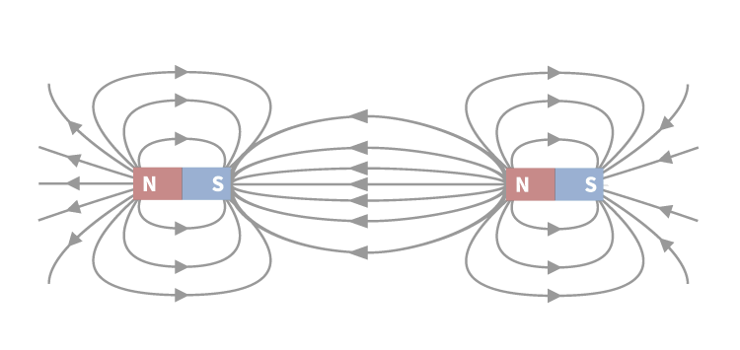
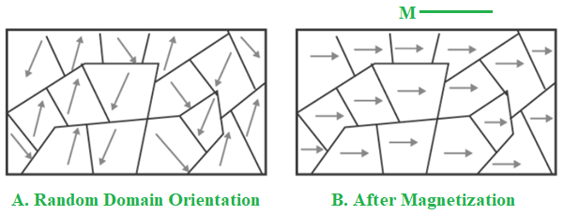
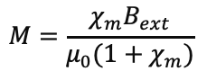
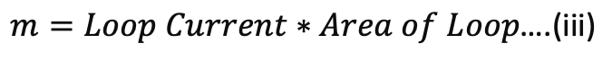
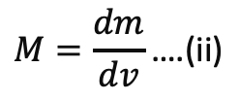
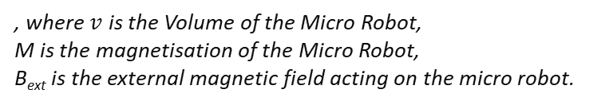
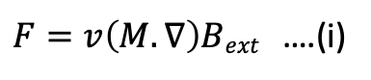
b. Designing of coils :
Force acting on the Micro Robot:
The magnetic micro robot has a non – uniform magnetic field which varies across space and even coil carrying current produces non – uniform magnetic field. The magnetic force acting on the magnetic micro robot due to non – uniform magnetic field is given by
$F=v\left(M.∇\right)Bext$ ….(i)
, where $v$ is the Volume of the Micro Robot,
M is the magnetisation of the Micro Robot,
B_{ext} is the external magnetic field acting on the micro robot.
Magnetisation (M) is the magnetic dipole moment(m) per unit volume and magnetic dipole moment is given product of loop current and loop area in the direction of the loop area vector.
$$M=\frac{dm}{dv}\text{….(}\text{i}\text{i}\text{)}$$
and
$$m=Loop Current∗Area of Loop\text{….(}\text{i}\text{ii}\text{)}$$
Fig 4. Orientation of Magnetic Dipoles, in presence of magnetic fields
It is found that the Magnetisation is dependent on the type of material of the micro robot.
In case of a permanent magnet, M is considered a constant and is given by manufacturer.
In case of a ferromagnet, M is given by
$$M=\frac{χ_{m}B_{ext}}{μ_{0}(1+χ_{m})}$$
….(iv)
${, where χ}_{m}$is the magnetic susceptibility of the medium in which
the magnetic field is to be calculated and μ₀ = 4π × 10⁻⁷ is the permeability of free space.
References:
I.E. Tamm Fundamentals of Theory of Electricity
https://www.geeksforgeeks.org/ferromagnetism-definition-causes-properties-hysteresis/
https://byjus.com/jee-questions/can-two-magnetic-fields-interact/

Slide 12
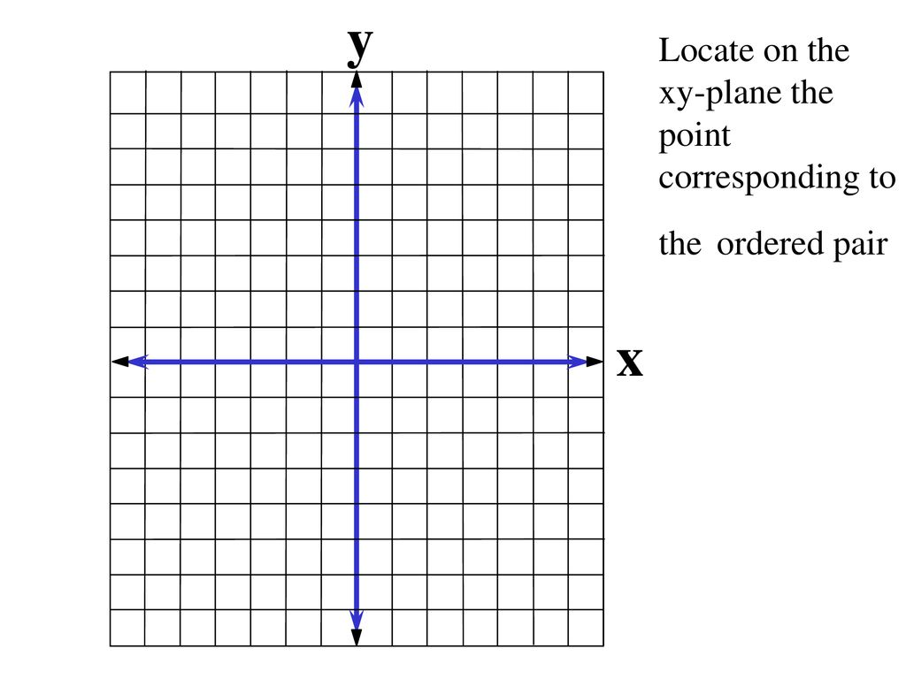
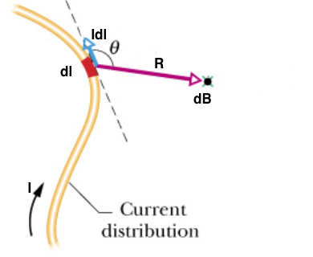
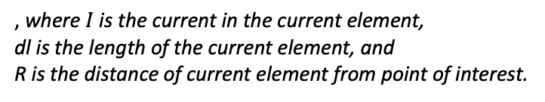
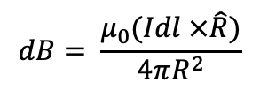
External field generation at a point due to a current carrying element:
The micro robot should be able to manoeuvre in different directions on the 2D platform and that is possible by changing the direction of force acting on the micro robot. From (i) we could see that force acting on the bot is dependent on
Gradient of external magnetic flux density.
Magnitude of Magnetic flux density.
Magnetic flux density at any point, due to a current element is given by Biot – Savart’s Law in electromagnetism, and the equation is
$$dB= \frac{μ_{0}(Idl ×\hat{R})}{4πR^{2}}$$
….(v)
, where $I$is the current in the current element,
dl is the length of the current element, and
R is the distance of current element from point of interest.
I
Fig 6. 2D view of coil on XY plane
Fig 5. Application of Biot – Savart’s Law
References: https://opentextbc.ca/universityphysicsv2openstax/chapter/magnetic-force-on-a-current-carrying-conductor/

Slide 13

Reason for choosing PCB as a 2D platform over a grid of Solenoids:
Availability of Microfabrication of Coils on PCB.
Gap between micro robot and coil should be as low as possible (PCB gives 15um).
Localized field generation to maneuver multiple bots at a given instant of time.
The orientation and position of coils is fixed and remains stationary with respect to each other even under influence of external disturbances.
Easily Scalable.

Slide 14
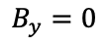
Contents:
Field due to a single wire of finite length.
Comparison of Analytical Results with COMSOL.
Gradient of Field due to single wire.
Force acting on bot due to single wire.
a) Magnetic field of a straight wire segment with finite length:
Consider, a current wire of finite length (A – B), carrying a Current ‘I’ is placed on X-Y plane and parallel to Y – axis , at a distance ‘a’ from origin.
By applying Biot – Savart’s Law, we get the magnetic flux density at any point in space P (x, y, z) as given in below equations.
B (a, y₂)
a
P (x, y, z)
A (a, y₁)
Fig 7. Conductor carrying current I, placed at a distance ‘a’ from origin parallel to Y-axis on X-Y Plane
I
$$B_{x}=\frac{μ_{0}zI}{4π[(a−x)^{2}+z^{2}]}×\left[\frac{y_{2} −y}{\sqrt{{(y_{2}−y)}^{2} +{(a−x)}^{2}+z^{2}}} −\frac{y_{1} −y}{\sqrt{{(y_{1}−y)}^{2} +{(a−x)}^{2}+z^{2}}}\right]$$
….(vi)
$$B_{y}=0$$
….(vii)
$$B_{z}=\frac{−μ_{0}(a−x)I}{4π[(a−x)^{2}+z^{2}]}×\left[\frac{y_{2} −y}{\sqrt{{(y_{2}−y)}^{2} +{(a−x)}^{2}+z^{2}}} −\frac{y_{1} −y}{\sqrt{{(y_{1}−y)}^{2} +{(a−x)}^{2}+z^{2}}}\right]$$
….(viii)
Reference: Modeling and optimization of planar microcoils

Slide 15
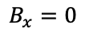
Contents:
Field due to a single wire of finite length.
Comparison of Analytical Results with COMSOL.
Gradient of Field due to single wire.
Force acting on bot due to single wire.
a) Magnetic field of a straight wire segment with finite length:
Similarly, when the line segment is placed on X-Y plane and parallel to X-axis, at a distance ‘a’ from origin, the magnetic flux density at any point in space P(x, y, z) is given as
B (x₂, a)
A (x₁, a)
I
a
P (x, y, z)
Fig 8. Conductor carrying current I, placed at a distance ‘a’ from origin parallel to X-axis on X-Y Plane
$$B_{x}=0$$
….(ix)
$$B_{y}=\frac{−μ_{0}zI}{4π[(a−y)^{2}+z^{2}]}×\left[\frac{x_{2} −x}{\sqrt{{(x_{2}−x)}^{2} +{(a−y)}^{2}+z^{2}}} −\frac{x1 −x}{\sqrt{{(x_{1}−x)}^{2} +{(a−y)}^{2}+z^{2}}}\right]$$
….(x)
$$B_{z}=\frac{−μ_{0}(a−y)I}{4π[(a−y)^{2}+z^{2}]}×\left[\frac{x2 −x}{\sqrt{{(x_{2}−x)}^{2} +{(a−y)}^{2}+z^{2}}} −\frac{x_{1} −x}{\sqrt{{(x_{1}−x)}^{2} +{(a−y)}^{2}+z^{2}}}\right]$$
….(xi)
Reference: Modeling and optimization of planar microcoils

Slide 16
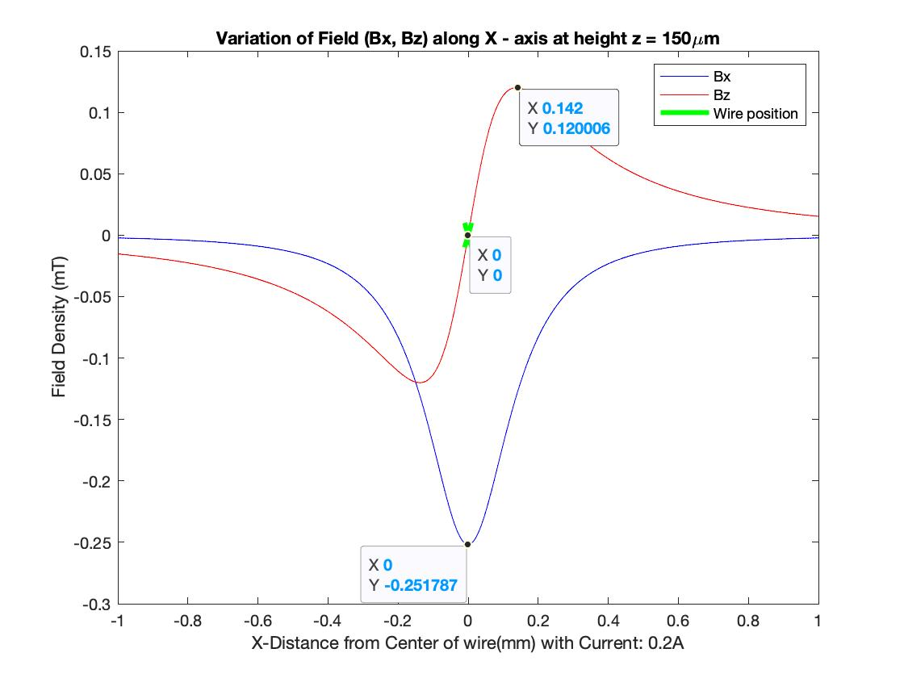
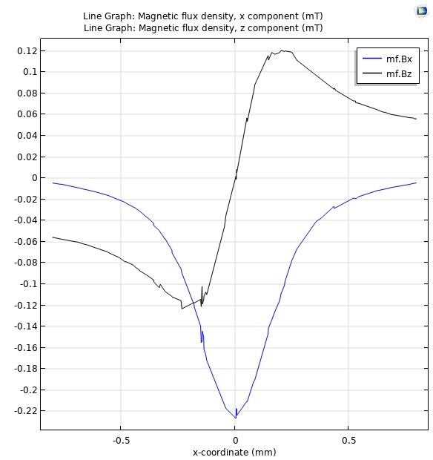
Contents:
Field due to a single wire of finite length.
Comparison of Analytical Results with COMSOL.
Gradient of Field due to single wire.
Force acting on bot due to single wire.
b) Comparison of Analytical Results with COMSOL:
I
Fig 9. Analytical Result of Variation in Field
(wire is into the plane)
Fig 10. COMSOL Result of Variation in Field

Slide 17
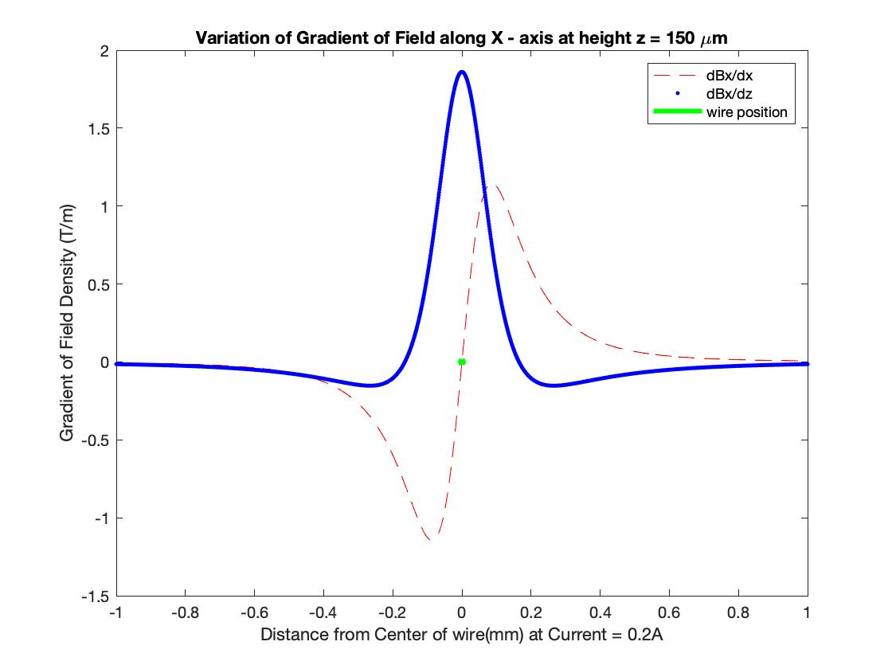
Contents:
Field due to a single wire of finite length.
Comparison of Analytical Results with COMSOL.
Gradient of Field due to single wire.
Force acting on bot due to single wire.
I
Fig 11. Analytical Result of Variation of Gradient in Field
(wire is into the plane)

Slide 18
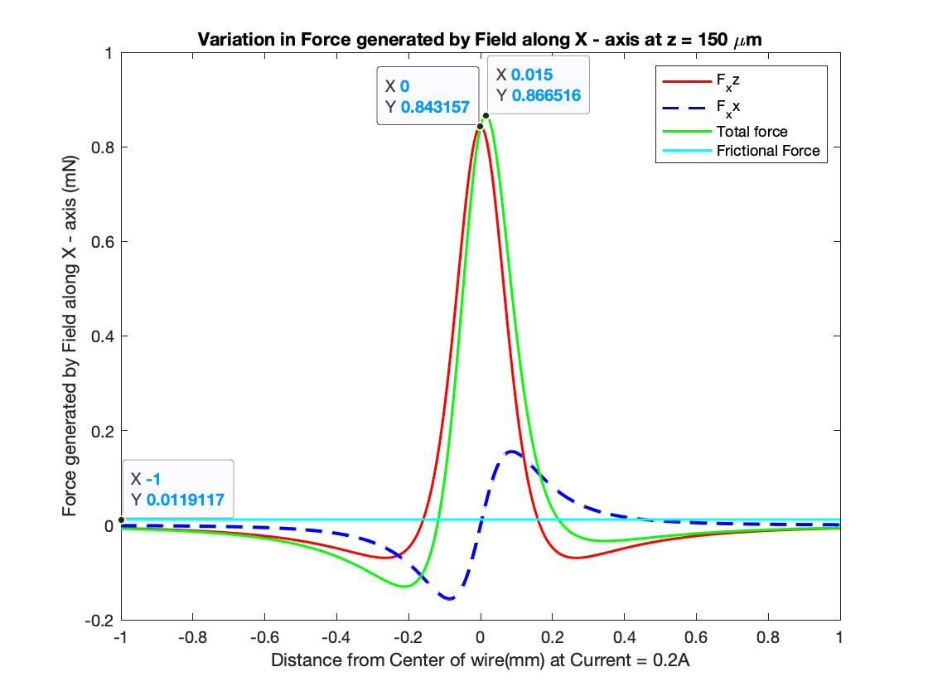
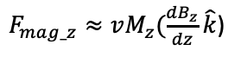
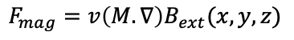
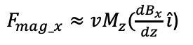
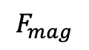
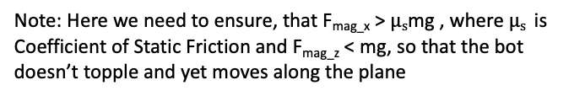
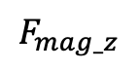
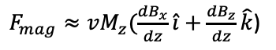
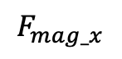
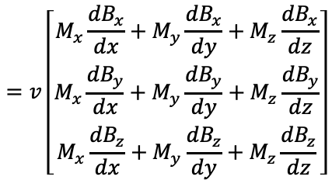
Contents:
Field due to a single wire of finite length.
Comparison of Analytical Results with COMSOL.
Gradient of Field due to single wire.
Force acting on bot due to single wire.
Variation of Magnetic Force along X – axis, when the wire is placed along Y-axis
$$=v\left[\begin{matrix}M_{x}\frac{{dB}_{x}}{dx}+M_{y}\frac{{dB}_{x}}{dy}+M_{z}\frac{{dB}_{x}}{dz} \\ M_{x}\frac{{dB}_{y}}{dx}+M_{y}\frac{{dB}_{y}}{dy}+M_{z}\frac{{dB}_{y}}{dz} \\ M_{x}\frac{{dB}_{z}}{dx}+M_{y}\frac{{dB}_{z}}{dy}+M_{z}\frac{{dB}_{z}}{dz}\end{matrix}\right]$$
….(xii)
$$F_{mag}=v\left(M.∇\right)B_{ext}(x,y,z)$$
, where M_{x}, M_{y}, M_{z} are Magnetization along X, Y & Z axis respectively and in case of cylindrical bot
M_{z} >> (M_{x} , M_{y})
$F_{mag}≈vM_{z}(\frac{{dB}_{x}}{dz}\hat{i}+\frac{{dB}_{z}}{dz}\hat{k}$)
….(xiii)
$F_{mag_z}≈vM_{z}(\frac{{dB}_{z}}{dz}\hat{k}$)
$$F_{mag_z}$$
….(xiv)
$$F_{mag}$$
$F_{mag_x}≈vM_{z}(\frac{{dB}_{x}}{dz}\hat{i}$)
….(xv)
$$F_{mag_x}$$
Note: Here we need to ensure, that F_{mag_x} > $μs$mg , where $μs$ is Coefficient of Static Friction and F_{mag_z} < mg, so that the bot doesn’t topple and yet moves along the plane
Fig 12. Analytical Result of Variation
of Force on bot (wire is into the plane)
Reference: Local magnetic field system design and control for independent control of multiple mobile microrobots

Slide 19
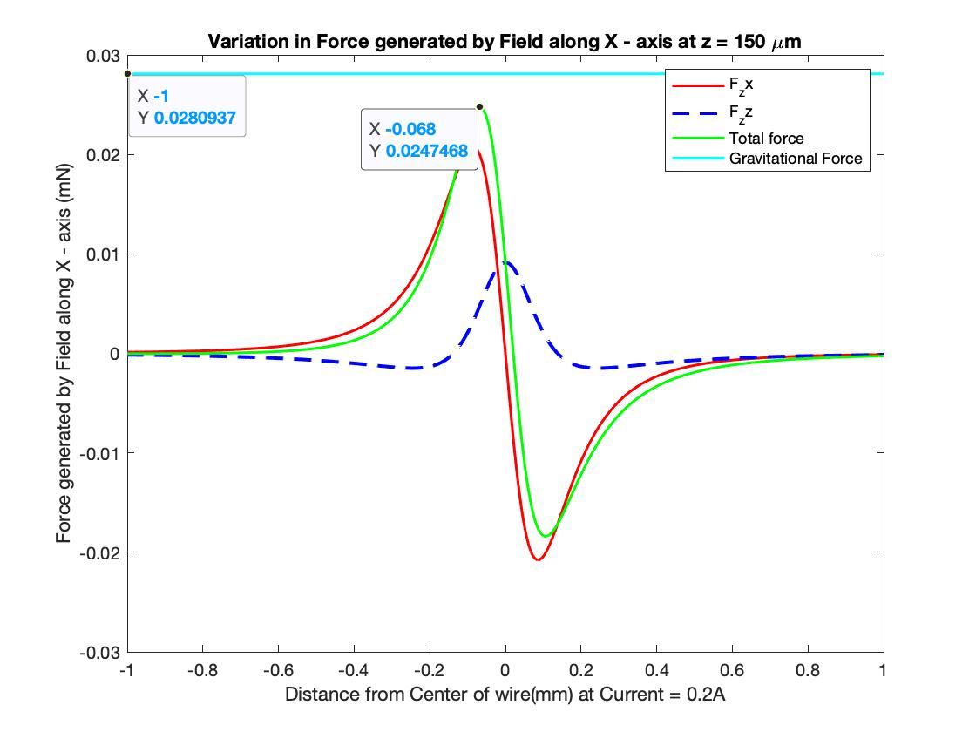
Contents:
Field due to a single wire of finite length.
Comparison of Analytical Results with COMSOL.
Gradient of Field due to single wire.
Force acting on bot due to single wire.
Comparison of Fmag_x and Fmag_z so that the robot moves in X-Y plane:
Z
Fig 13. F_{mag_x}
Fig 14. F_{mag_z}

Slide 20
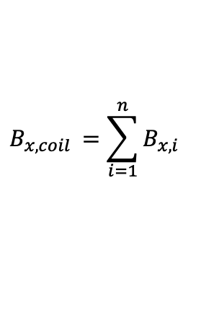
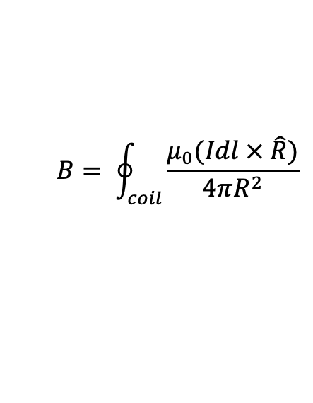
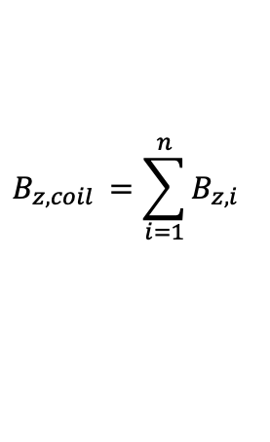
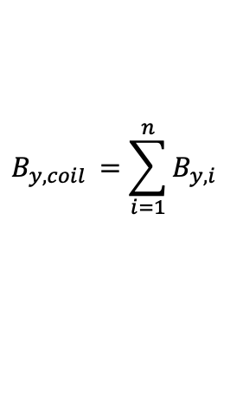
Magnetic field of a rectangular coil:
Contents:
Field due to Coil
Variation of Force due to
Multiple Turns in same Plane
Magnitude of Current
Spacing between wires
No. of PCB Layers
Comparison of Force acting on Permanent Magnet and Ferro Magnet.
Biot - Savart’s law follows the principle of Superposition i.e., the total field due to multiple coils acting on a point is the summation of individual fields acting on the given point.
The magnetic flux density of all segments of a rectangular planar coil can be determined by superposition of the field vectors of all the horizontal and vertical segments:
$$B= \oint_{coil}^{ }{\frac{μ_{0}(Idl × \hat{R})}{4πR^{2}}}$$
….(xvi)
$$B_{x, coil }=\sum_{i=1}^{n}{B_{x,i}}$$
….(xvii)
I
$$B_{y, coil }=\sum_{i=1}^{n}{B_{y,i}}$$
Fig 15. 2D view of coil on XY plane
….(xviii)
$$B_{z, coil }=\sum_{i=1}^{n}{B_{z,i}}$$
….(xix)
Reference: Modeling and optimization of planar microcoils

Slide 21
3D View of Magnetic field of a rectangular coil:

Slide 22
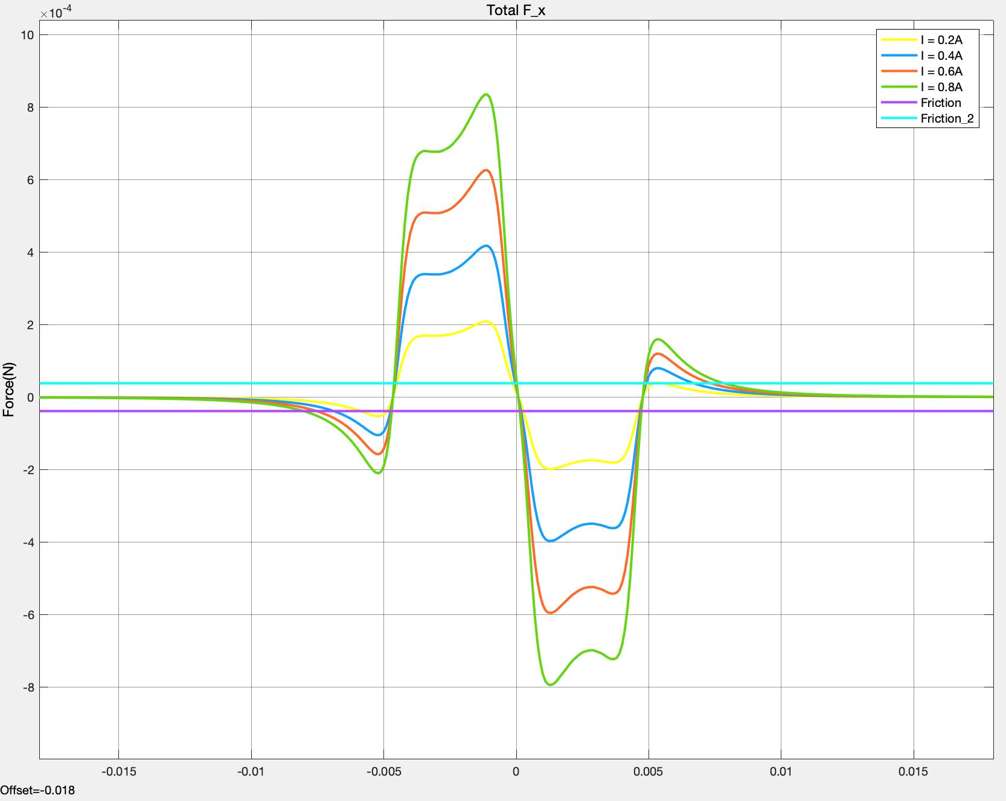
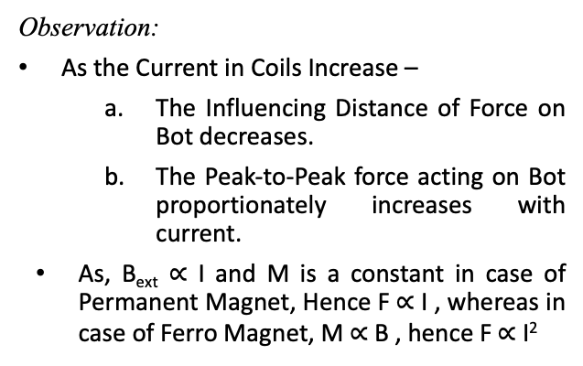
Variation of Force
a) Changing the Current in the coils:
Variation of F_x w.r.t Current
10
8
6
4
2
0
-2
-4
-6
-8
Contents:
Field due to Coil
Variation of Force due to
Magnitude of Current
Multiple Turns in same Plane
No. of PCB Layers
Height Variation
Comparison of Force acting on Permanent Magnet and Ferro Magnet.
Observation:
As the Current in Coils Increase –
The Influencing Distance of Force on Bot decreases.
The Peak-to-Peak force acting on Bot proportionately increases with current.
As, B_{ext} $∝$ I and M is a constant in case of Permanent Magnet, Hence F $∝$ I , whereas in case of Ferro Magnet, M $∝$B , hence F $∝$I²
Force on Bot(N)
-15. -10 -5 0 5 10 15
Distance (mm)
Current(A) | Peak-Peak Magnitude(mN) | %Improvement | Influencing Distance (mm) | %Improvement
0.2 | 0.407 |  | 10.58
0.4 | 0.814 | 100 | 10.48 | -0.9
0.6 | 1.222 | 199.75 | 10.36 | -2.07
0.8 | 1.63 | 300.49 | 10.14 | -4.15
Fig 16. Analytical Result of Variation
of Force on bot w.r.t Current
Table 2

Slide 23
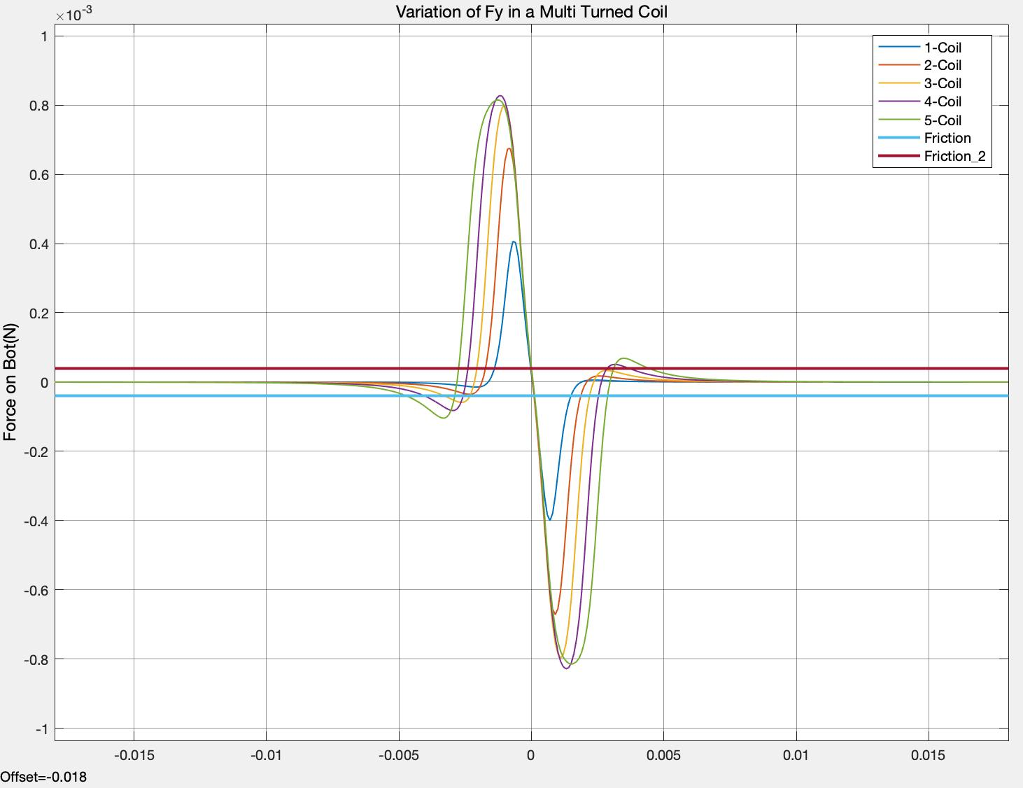
Variation of F_y w.r.t No. of Turns
1
0.8
0.6
0.4
0.2
0
-0.2
-0.4
-0.6
-0.8
-1
Variation of Force
b) Multiple Turns in same plane.
Contents:
Field due to Coil
Variation of Force due to
Magnitude of Current
Multiple Turns in same Plane
No. of PCB Layers
Height Variation
Comparison of Force acting on Permanent Magnet and Ferro Magnet.
Observation:
As the no. of Turns Increase –
The Influencing Distance of Force on Bot increases.
The peak force value increases as no. of turns in the coil increase.
Force on Bot(N)
-15 -10 -5 0 5 10 15
Distance (mm)
No. of Turns | Peak Magnitude(mN) | %Improvement | Influencing Distance (mm) | %Improvement
1 | -4.064 |  | 4
2 | -6.747 | 66.01 | 4.8 | 20
3 | -7.982 | 96.40 | 6.1 | 52.5
4 | -8.277 | 103.66 | 7.8 | 95
5 | -8.146 | 100.44 | 9.3 | 132.5
Fig 17. Analytical Result of Variation
of Force on bot w.r.t No. of Turns
Table 3

Slide 24
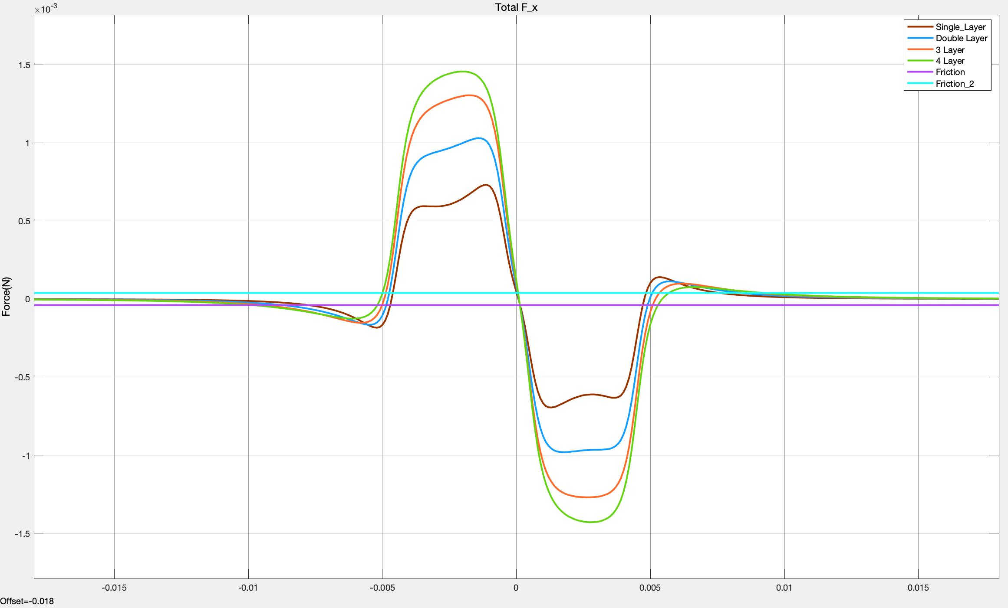
Variation of F_x w.r.t No. of Layers
Variation of Force
c)Variation in Layers between Coils:
1.5
1
0.5
0
-0.5
-1
-1.5
Contents:
Field due to Coil
Variation of Force due to
Magnitude of Current
Multiple Turns in same Plane
No. of PCB Layers
Height Variation
Comparison of Force acting on Permanent Magnet and Ferro Magnet.
Observation:
As the PCB layers Increase –
The Influencing Distance of Force on Bot increases.
Magnitude of Force increases by a significant amount.
Force on Bot(N)
-15 -10 -5 0 5 10 15
Distance (mm)
No. of Layers | Peak-Peak Magnitude (mN) | %Improvement | Influencing Distance (mm) | %Improvement
1 | 1.426 |  | 15.4
2 | 2.011 | 41.23 | 17.2 | 11.68
3 | 2.575 | 80.57 | 18.5 | 20.12
4 | 2.886 | 102.38 | 19.1 | 24.02
Fig 18. Analytical Result of Variation
of Force on bot w.r.t No. of Layers
Table 4

Slide 25
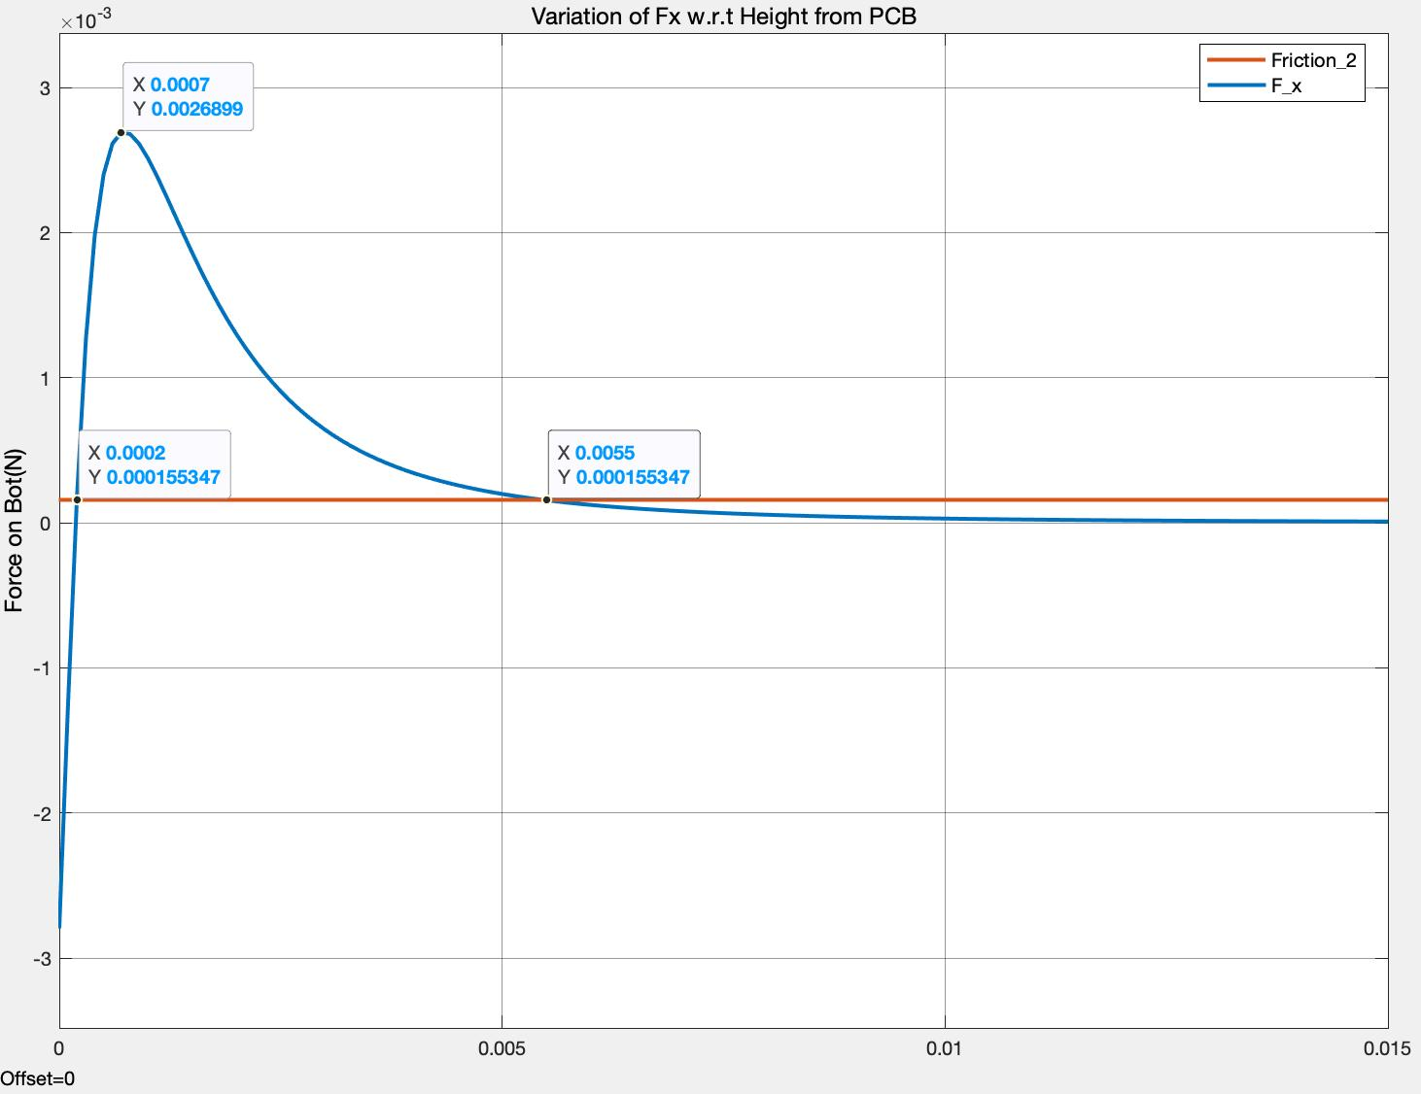
Variation of Force
d) Height Variation
Contents:
Field due to Coil
Variation of Force due to
Magnitude of Current
Multiple Turns in same Plane
No. of PCB Layers
Height Variation
Comparison of Force acting on Permanent Magnet and Ferro Magnet.
Variation of F_x w.r.t Height (away from PCB)
3
2
1
0
-1
-2
-3
Observation:
As we go higher from PCB–
The magnitude of Force even though increases for a height till 0.7mm, it reduces inversely afterwards.
The bot can move, only if the height away from PCB lies in the range of 0.2mm to 5.5 mm.
Force on Bot(N)
Height (m)
Fig 19. Analytical Result of Variation
of Force on bot w.r.t Height

Slide 26
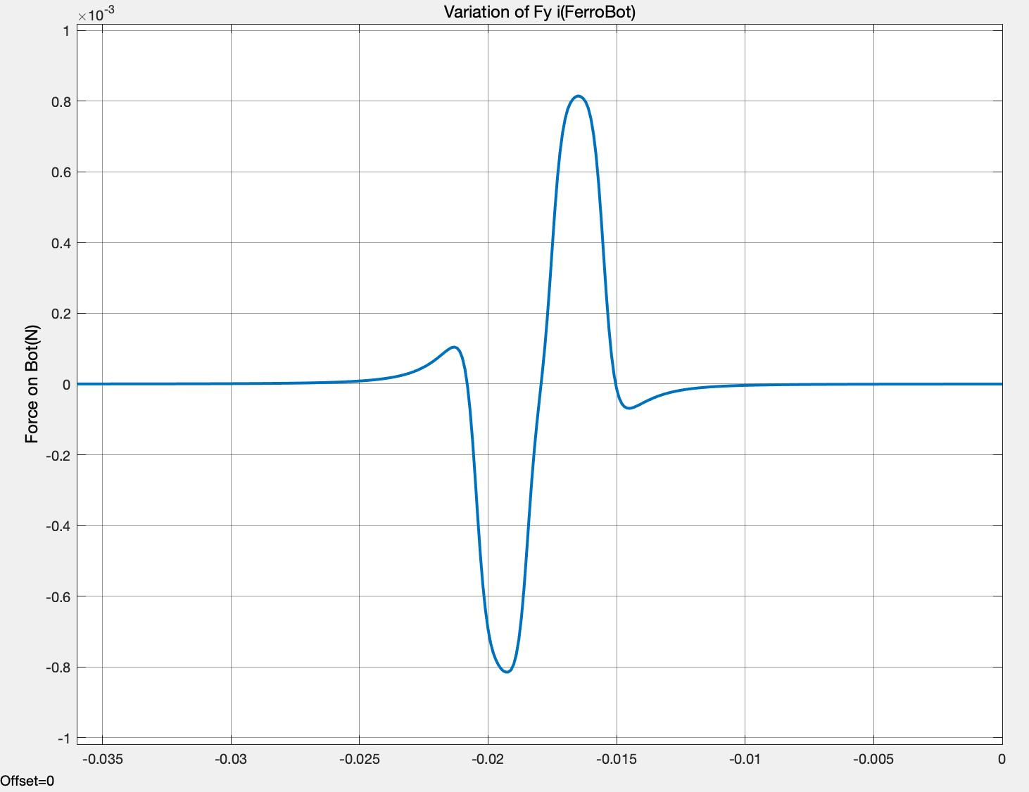
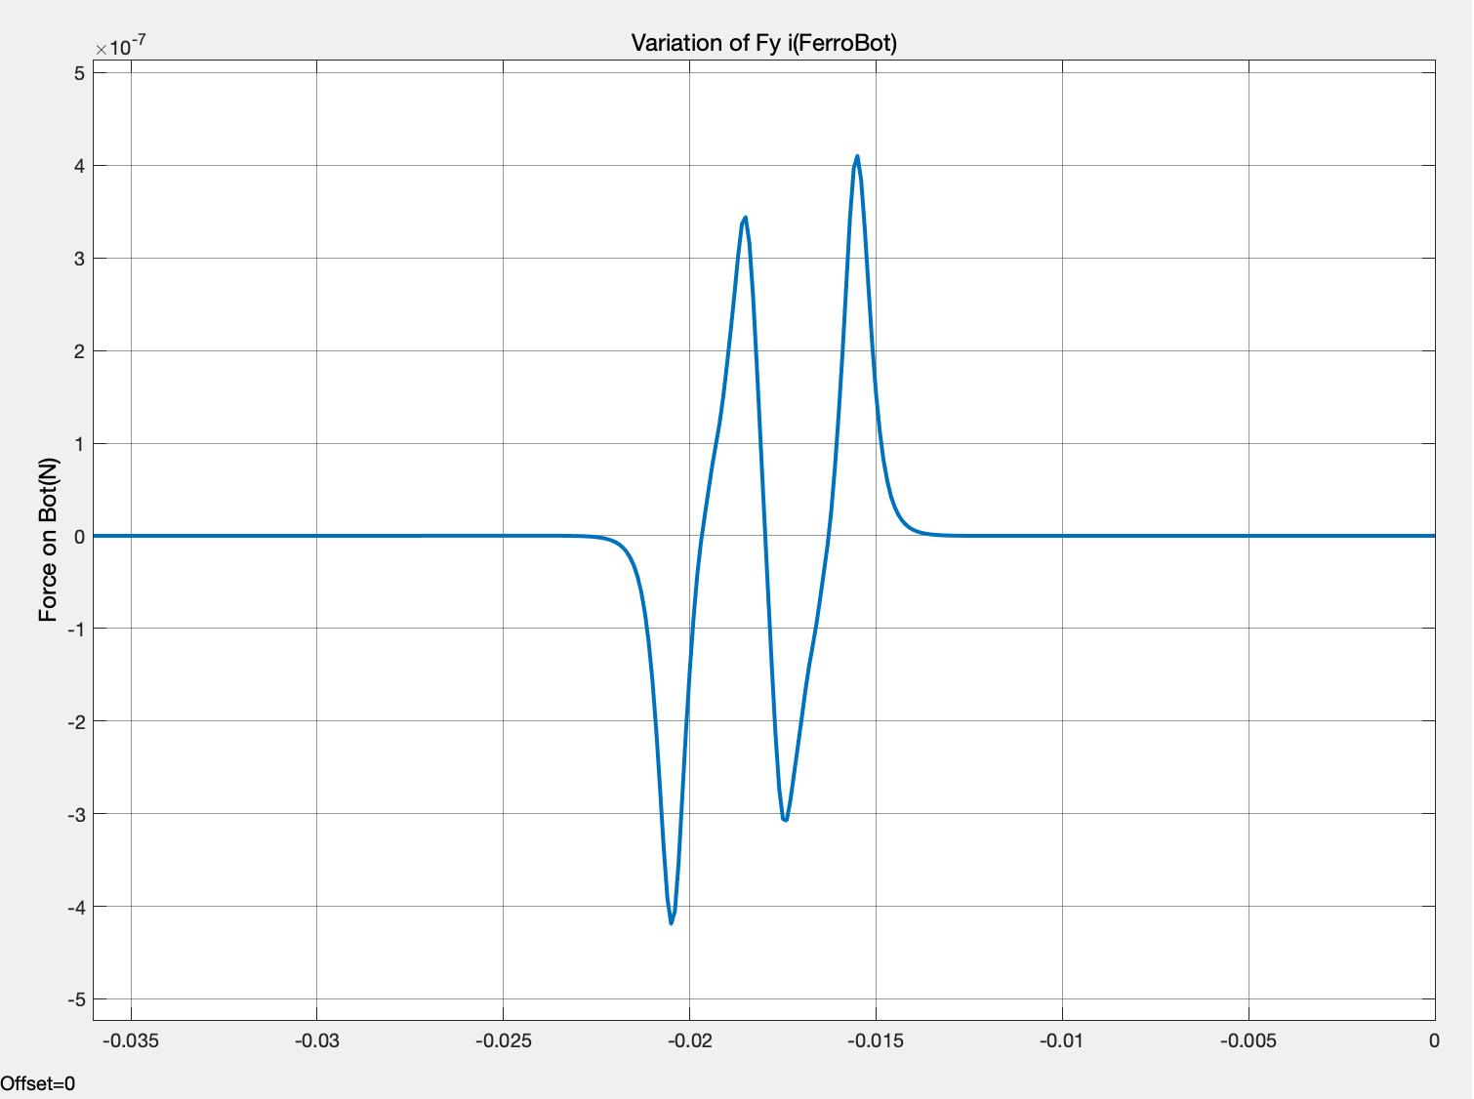
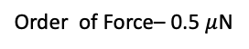
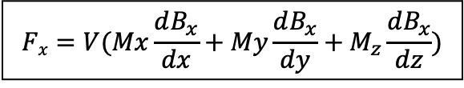
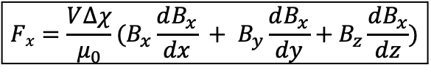

Comparison of Force acting on Micro-bot:
Variation of F_y (Permanent Magnet)
Variation of F_y (Ferro Magnet)
1
0.8
0.6
0.4
0.2
0
-0.2
-0.4
-0.6
-0.8
5
4
3
2
1
0
-1
-2
-3
-4
-5
Contents:
Field due to Coil
Variation of Force due to
Magnitude of Current
Multiple Turns in same Plane
No. of PCB Layers
Height Variation
Comparison of Force acting on Permanent Magnet and Ferro Magnet.
Order of Force – 1mN
Order of Force– 0.5 $μ$N
Force on Bot(N)
Force on Bot(N)
-15 -10 -5 0 5 10 15
-15 -10 -5 0 5 10 15
Distance (mm)
Distance (mm)
Fig 20 . Variation of Force on bot (Permanent Magnet)
Fig 21. Variation of Force on bot (Ferro Magnet)
$$Fx=V(Mx\frac{dB_{x}}{dx}+My\frac{dB_{x}}{dy}+M_{z}\frac{dB_{x}}{dz})$$
$$Fx={\frac{V∆χ}{μ_{0}}(B}_{x}\frac{dB_{x}}{dx} + B_{y}\frac{dB_{x}}{dy}+B_{z}\frac{dB_{x}}{dz})$$
….(xx)
….(xxi)
M_{x}, M_{y}, M_{z} is constant in case of Permanent Magnet, and M_{z} >> M_{x}, M_{z} >> M_{y} for a cylindrical magnet, V is the volume of the bot.
Since M = $\frac{Bext∆χ}{μ_{0}}$, in case of a Ferro Magnetic Bot

Slide 27
Design Choice for a PCB:
Parameters | Desired Variation | Design Choice
Influencing distance | Increase | Multiple Turned Coil Multiple Layered Coil
Magnitude of Force acting on Bot | Increase | High current carrying capacity Multi Layered Coil Multi Turned Coil
Table 5

Slide 28
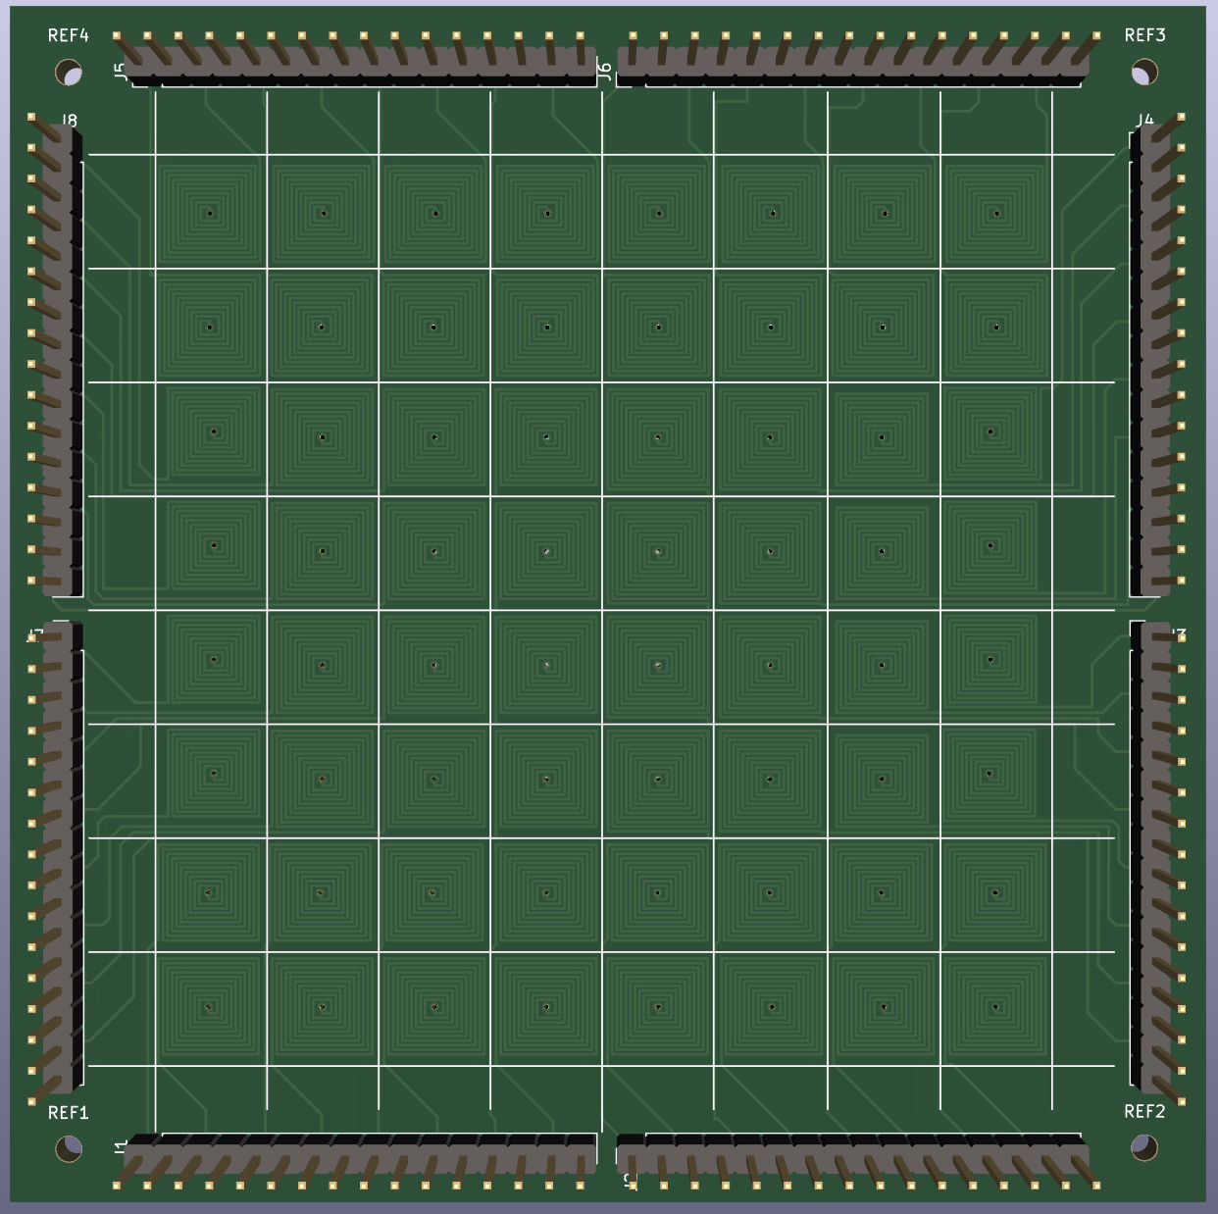
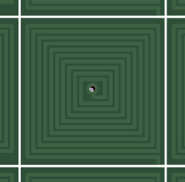

Final PCB Design*:
PCB Design Specifications:
No. of Coils – 64
PCB Layer – 2- 4
PCB Thickness – 0.3mm
9.8 mm
Thermal effects due to currents in PCB:
According to IPC 2221, The maximum allowable current in a PCB is given by
I = K. ∆T^{0.44}. (W.H)^{0.725} ,where ∆T is temperature rise above ambient in ºC, W is width of coil and H is the thickness of coil, K = 0.048 for external coils
105.2 mm
….(xxii)
9.8 mm
Coil Design Specifications:
No. of Turns – 8-10
Coil Width – 0.25mm
Spacing between coils – 0.15 mm
Coil Thickness – 0.035mm
Max Current Carrying Capacity – 1.2A for ∆T = 20 ºC
105.2 mm
Fig 22. PCB Design
*The design was made in Ki CAD 6.0
and was ordered from PowerPCB.

Slide 29
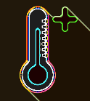
Losses in the Coil:
Theoretical Calculations:
a) Resistive Losses:
For a given current, (I) = 0.7A,
Resistance of Coil (R) = 1 Ohm,
then, the power dissipated in the form of heat in a coil is given by
P_{R} = I²R = 0.7^{2*}1 = 0.49W
….(xxiii)
b) Eddy Current Losses in Micro Bot:
NdFeB is a conductor of electricity and as it is experiencing varying magnetic field generated by coil, eddy currents
are produced in the bot and it’s magnitude is given by
P_{e} = K_{e}*f²*B_{max}²*t²
….(xxiv)
, where K_{e} is eddy current constant given by K_{e} = Volume/Resistivity(ρ_{m}) = 1.507*10⁻⁷/1.5*10⁻⁶
f is the frequency of current,
B_{max} is the maximum flux density produced by coil and
t is the thickness/height of the bot = 0.9mm
At f = 50 Hz, for I = 0.7 A, B_{max.} = 23 Gauss
P_{e} = 4.3 nanowatt

Slide 30

Agenda of Presentation:
Introduction
System Design
Experimental Verification
Control Strategy
Future Work
Field generated by Coil
Simulating the motion of Bot in MATLAB(Simscape)
Movement of bot captured with increased height from PCB

Slide 31

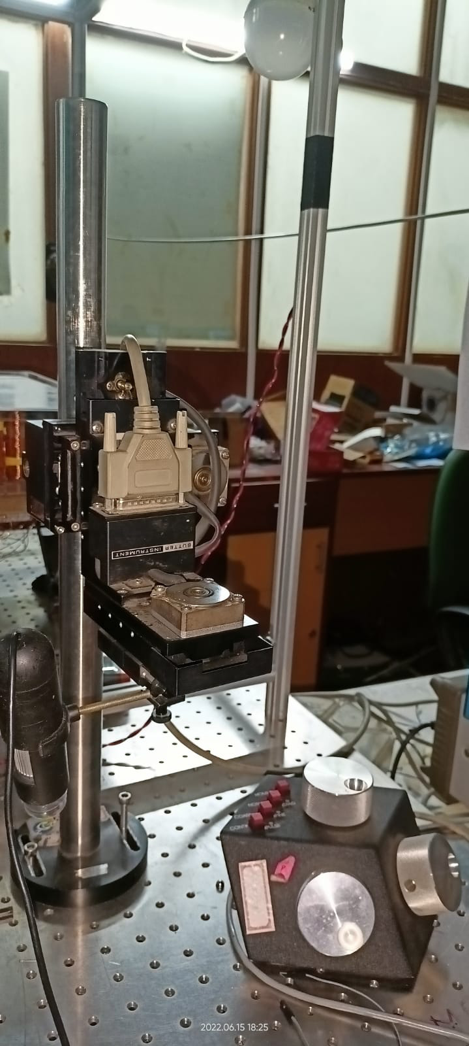
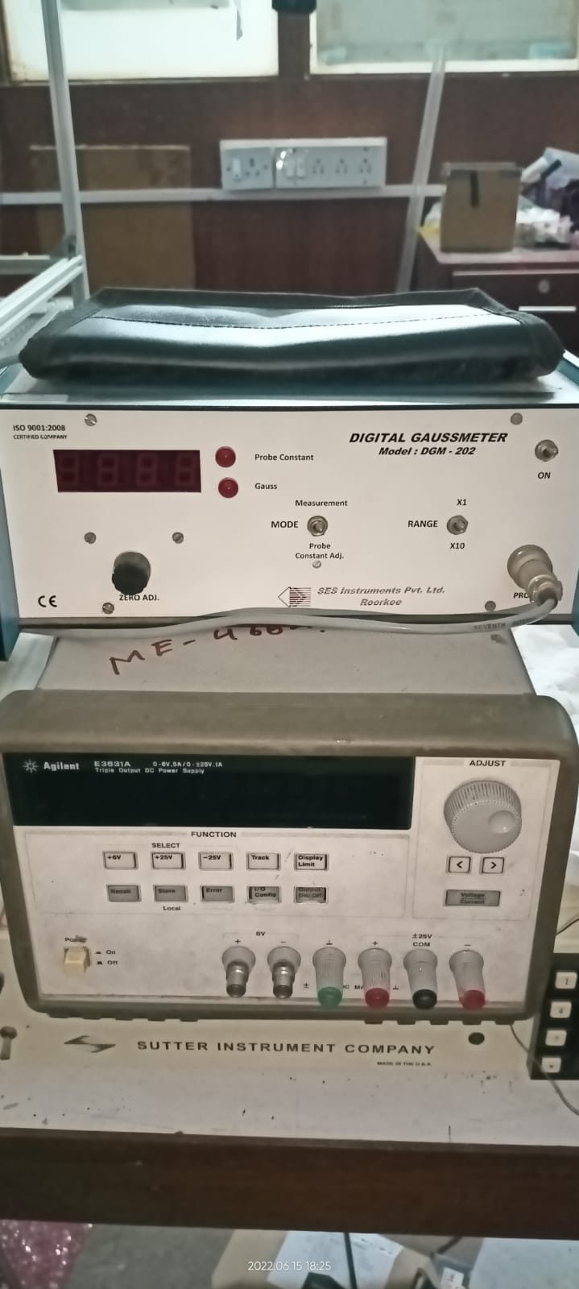
Experimental Verification:
a) Field generated by Coil:
B_{x}(Gauss)
Distance x (mm)
Fig 23. Precision Moving Equipment
Fig 24. Gauss Meter (SES Instruments) and Current Source (Agilent)
Fig 25. Comparison between Theoretical Field and Experimental Field (I = 0.3A)

Slide 32
Experimental Verification:
b) Simulating the motion of Bot in MATLAB(Simscape):
Video 3: Simulink Model replicating the dynamics of system
Video 5: Bot getting repelled from the coil
Video 4: Bot getting attracted to the coil

Slide 33

Experimental Verification:
c) Movement of bot captured with increased height from PCB
Fig. 26.New Design of Micro Robot with Casing
The bot is at a height 1mm from the surface,
the casing has 3 legs with holds the bot
Video 6: Bot getting attracted from Coil

Slide 34

Agenda of Presentation:
Introduction
System Design
Experimental Verification
Control Strategy
Future Work
Electronic Setup (Open Loop)
Electronic Setup (Closed Loop)
Image Processing
Getting Equilibrium Points
Results

Slide 35






Simplified Setup Schematic
SMPS
Output -DC 5V, 60A
Power- 300W
To power Driver IC, inturn drive current through the coils
Open-Loop Electronic testbed setup
PWM Driver IC- Adafruit PCA9685
Technical Features :
I2C Driven
16-Channel 12-bit PWM resolution (0 to 4095)
Can chain up to 62 of them
Each MX1919 Driver output requires two channels of PCA9685 (Step Pin & Direction Pin)
MX1919 Driver Module
Technical Specifications :
1. Module supply voltage: DC 2V-10V 2. Signal input voltage: DC 1.8-7V 3. Single working current: 1.5A 4. Peak current up to 2.5A
Can control 2 coils with both current and direction control
Arduino Controller
Serial communication with PC- coil ON/OFF info
I2C communication to PWM drivers (A4- SDA & A5-SCL)

Slide 36
Video: Open-Loop Linear Motion of Robot on PCB

Slide 37

System Components
before Connection

Slide 38

Need for Closed-Loop feedback system:
Position-based control is possible​.
Automatic navigation can be done from Point A to Point B​.
Multiple robots can be employed​
For the 2D PCB platform, a camera can be mounted to view the system, and information can be extracted using computer vision techniques​
Other techniques, like using an array of hall effect sensors to find position of robot can also be used​
Camera used - Logitech C270 with Manual Focus Ring

Slide 39

Setup Schematic with Camera Feedback

Slide 40

Determining Bots center location
1. Circle Hough Transform (CHT)
The Hough transform is a feature extraction technique used to detect shapes like lines, circles, etc
OpenCV library provides the Hough Transform function to the bot’s location in real-time. Returning center(x,y) and radius(r)
detected_circles = cv2.HoughCircles( Image, cv2.HOUGH_GRADIENT, 1, rows / 8, param1=50, param2=30, minRadius=8, maxRadius=14, )
2. Finding Contour and averaging the pixels on the contour
Reference - Link

Slide 41

Image Processing using OpenCV in python
Location on the PCB
Determining Coils Centers/Corners
Bots center– Location (x, y)
Color of the robot

Slide 42

Robot Path Planning - A* Algorithm Implementation
Path planning is a computational problem to find a sequence of valid configurations that moves the object from the source to the destination.
A* Search algorithm is one of the best and most popular techniques used in path-finding and graph traversals.
What A* Search Algorithm does is that it picks the node at each step according to a value-F = G + H. At each step, it selects the node/cell having the lowest ‘F’ and processes that node/cell. G = the movement cost to move from the starting point to a given square on the grid, following the path generated to get there. H = the estimated movement cost to move from that given square on the grid to the final destination.
Reference- Link

Slide 43


Variation of Force generated w.r.t distance from center:

Slide 44


Local Equilibrium Point Modeling -Points of lowest magnetic potential:
Possible Movements- 1. Corner to Center 2. Center to Corner

Slide 45

Overall System
with Camera Mount

Slide 46

Final System

Slide 47
Single bot Movement:

Slide 48
Multiple bot Movement:

Slide 49
Single bot- Astar movement tracking:

Slide 50
Multiple bot- Astar movement tracking:

Slide 51


Application: Part re-orientation demo
Initial Angle = -7º
Final Angle = -12º

Slide 52


Agenda of Presentation:
Introduction
System Design
Experimental Verification
Control Strategy
Future Work

Slide 53
Future Work:
The size of the coils can be further reduced to match the size of the micro robots.
Integrating Electronic Setup with the PCB, to make the system more compact.
Using Flexible PCBs instead of a Rigid to achieve manoeuvring on flexible platforms.
The bot can be designed in a way to achieve torque control, which helps in orienting the bot at the same place.
Part Re-orientation by use of Multiple Bots.
Assembly and disassembly of Non magnetic-parts

Slide 54
Thank You !! Credits- Prof. G K Ananthasuresh, Prof. Kaushik Chatterjee, Mr. Sudhanva Bhat (PhD – Mechanical)
Note- All videos are deleted to reduce upload size for github

